Slide 1


Andriy Savka
September 10, 2022

Slide 2

Outline
Executive Summary
Introduction
Methodology
Results
Conclusion
Appendix

Slide 3
Executive Summary
Data was collected from two sources: SpaceX Rest API and Web scraping Falcon 9 launch records from Wikipedia. Data wrangling consists of the following steps. Data from SpaceX Rest API was retrieved in JSON format and converted into Pandas data frame. Web scraping data from Wikipedia was processed and converted into Pandas data frame. Exploratory data analysis (EDA) using visualization and SQL revealed potential predictors. Interactive visual analytics using Folium and Plotly Dash further facilitated data exploration. Predictive analysis was performed using the following classification models: logistic regression, SVM, decision-tree classifier, and k-nearest-neighbors classifier.
Data analysis revealed the following. Earlier launches had lower success rate than the later ones. Launces with higher payload mass had higher success rate. Launches for orbits ES-L, GEO, HEO, and SSO has outstanding success rate, while launches to the orbit SO were highly unsuccessful. Over time launches switched to different orbits. The highest percentage of successful launches happened on site KSC LC-39A. 76.9% launches on this site were successful. Overall success rate since 2013 kept increasing till 2020. Total payload mass of all launches is 45596 kg. Four ML models were built to predict outcomes a prospective lunch. K-nearest neighbor model has the highest predictive accuracy both for training and test sets (85% and 83%).

Slide 4
Introduction
SpaceX is one of the most efficient companies that launches cargo, satellites, and maned missions into space. SpaceX was able to decrease the cost of a launch from average 165 to 62 million dollars by utilizing rockets Falcon 9 with reusable first stage.
Cost of a launch depends on whether a rocket can successfully land and, thus, can be reused for future launches. The goal of this project is to determine the cost of launch by predicting if the first stage can be reused relying on public information available via various online sources.

Slide 5

Section 1

Slide 6
Methodology
Executive Summary
Data collection methodology
Data was collected from two sources: SpaceX Rest API and Web scraping Falcon 9 launch records from Wikipedia
Data wrangling
Data from SpaceX Rest API was retrieved in JSON format and converted into Pandas data frame. Web scraping data from Wikipedia was processed and converted into Pandas data frame.
Exploratory data analysis (EDA) using visualization and SQL
Interactive visual analytics using Folium and Plotly Dash
Predictive analysis using classification models
Dataset was standardized and then split between training and test sets in 0.8-0.2 proportion. Cross-validation grid search was performed to choose the most appropriate parameters for four ML models (logistic regression, SVM, decision-tree classifier, k-nearest-neighbors classifier). Model evaluation was based on R-squared parameter.

Slide 7
Data Collection
Data was collected from two sources: SpaceX Rest API and Web scraping Falcon 9 launch records from Wikipedia
In order to get data from SpaceX Rest API, we used ‘requests’ package
Web scraping Falcon 9 launch records from Wikipedia was done utilizing ‘BeautifulSoap’ package

Slide 8
Data Collection – SpaceX API
‘requests’ package was used to get data from SpaceX Rest API
Data was transformed from JSON dictionary into Pandas data frame
Data frame was filtered to include Falcon 9 launches only
GitHub URL of the completed SpaceX API calls notebook:
https://github.com/andriy-savka/IBM-Applied-Data-Science-Capstone/blob/953d95ec850e538f7c763bddb8e046a0a7d1d9bd/jupyter-labs-spacex-data-collection-api.ipynb
Get data from SpaceX Rest API
Transform data from JSON dictionary into Pandas data frame
Filter results to include data on Falcon 9 launces only

Slide 9
Data Collection - Scraping
‘requests’ and ‘BeautifulSoap’ packages were used to get data from Wikipedia page “List of Falcon 9 and Falcon Heavy launches”
Column names were extracted from the HTML table header
A data frame was created by parsing the launch HTML tables
GitHub URL of the completed web scrapping from Wikipedia page notebook:
https://github.com/andriy-savka/IBM-Applied-Data-Science-Capstone/blob/953d95ec850e538f7c763bddb8e046a0a7d1d9bd/jupyter-labs-webscraping.ipynb
Scrap data from Wikipedia page
Column names extracted from HTML table header
Data frame created by parsing HTML tables

Slide 10
Data Wrangling
Missing values in the variable ‘PayloadMass’ were replaced by the mean of ‘PayloadMass’
Missing values in the variable ‘LandingPad’ will become a separate category
A landing outcome label from ‘Outcome’ column was created
GitHub URL of completed data wrangling related notebooks:
https://github.com/andriy-savka/IBM-Applied-Data-Science-Capstone/blob/953d95ec850e538f7c763bddb8e046a0a7d1d9bd/jupyter-labs-spacex-data-collection-api.ipynb
https://github.com/andriy-savka/IBM-Applied-Data-Science-Capstone/blob/953d95ec850e538f7c763bddb8e046a0a7d1d9bd/labs-jupyter-spacex-Data%20wrangling.ipynb

Slide 11
EDA with Data Visualization
Summarize what charts were plotted and why you used those charts
In order to understand how various predictors correspond with launch outcomes (target variable) and between each other, we plotted a series of scatter plots: Flight Number against Payload Mass, Flight Number and Launch Site, Payload and Launch Site, Flight Number and Orbit Type, Payload and Orbit Type
We also visualized the launch success trend to understand dynamic of target variable
Success rate of each orbit type was plotted to learn about differences correlation between launch outcomes and orbit type
GitHub URL of completed EDA with data visualization notebook:
https://github.com/andriy-savka/IBM-Applied-Data-Science-Capstone/blob/953d95ec850e538f7c763bddb8e046a0a7d1d9bd/jupyter-labs-eda-dataviz.ipynb

Slide 12
EDA with SQL
The following aspects of the daset were studied via performing SQL queries as a part of EDA phase:
The names of the unique launch sites in the space mission
5 records where launch sites begin with the string 'CCA’
The total payload mass carried by boosters launched by NASA (CRS)
Average payload mass carried by booster version F9 v1.1
A list the date when the first successful landing outcome in ground pad was achieved.
A list the names of the boosters which have success in drone ship and have payload mass greater than 4000 but less than 6000
A list the total number of successful and failure mission outcomes
A list the names of the booster versions which have carried the maximum payload mass
A list the records which displayed the month names, failure landing outcomes in drone ship, booster versions, launch site for the months in year 2015
A rank the count of successful landing outcomes between the date 04-06-2010 and 20-03-2017 in descending order
GitHub URL of completed EDA with SQL notebook:
https://github.com/andriy-savka/IBM-Applied-Data-Science-Capstone/blob/953d95ec850e538f7c763bddb8e046a0a7d1d9bd/jupyter-labs-eda-sql-coursera_sqllite.ipynb

Slide 13
Build an Interactive Map with Folium
The following objects were added to the Folium map:
Using ‘folium.Circle’ and ‘folium.Marker’, we added circles to the map for each launch site in data frame
Via ‘market_claster’, we visualized successful and failed launches for each launch site
Utilizing ‘folium.PolyLine’, we visualized the shortest path from a launch side to the closest coastline
GitHub URL of completed interactive map with Folium map:
https://github.com/andriy-savka/IBM-Applied-Data-Science-Capstone/blob/953d95ec850e538f7c763bddb8e046a0a7d1d9bd/lab_jupyter_launch_site_location.ipynb

Slide 14
Build a Dashboard with Plotly Dash
We build an interactive Plotly Dashboard with the following graphs and interaction elements:
Dropdown list to enable Launch Site selection and a slider to select payload range
A pie chart to show the total successful launches count for all sites and a scatter chart to show the correlation between payload and launch success
GitHub URL of completed Plotly Dash dashboards:
https://github.com/andriy-savka/IBM-Applied-Data-Science-Capstone/blob/953d95ec850e538f7c763bddb8e046a0a7d1d9bd/spacex_dash_app.py

Slide 15
Predictive Analysis (Classification)
Dataset was standardized and then split between training and test sets in 0.8-0.2 proportion
For each model, cross-validated grid search was performed to choose the most appropriate parameters
The following models were built:
Logistic regression
SVM
Decision-tree classifier
K-nearest-neighbors classifier
Model evaluation parameter is R-squared (default parameter for Scikit-learn method ‘.score()’)
GitHub URL of completed predictive analysis:
https://github.com/andriy-savka/IBM-Applied-Data-Science-Capstone/blob/953d95ec850e538f7c763bddb8e046a0a7d1d9bd/SpaceX_Machine%20Learning%20Prediction_Part_5.ipynb

Slide 16
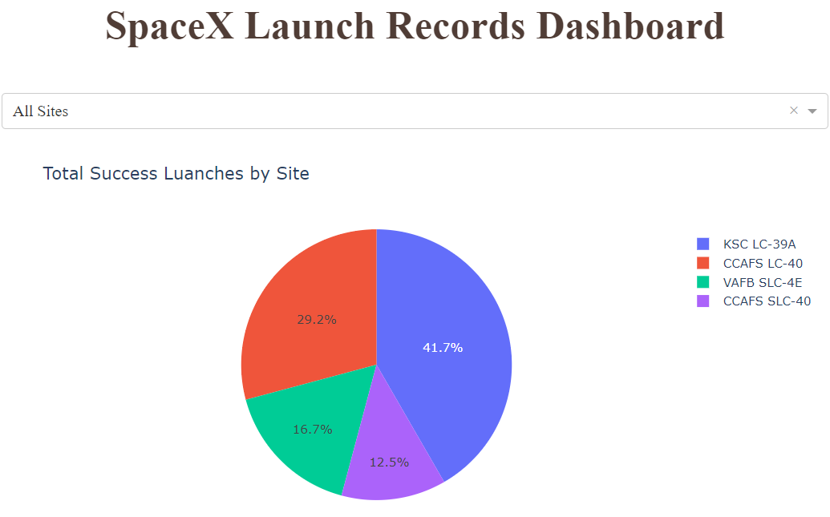
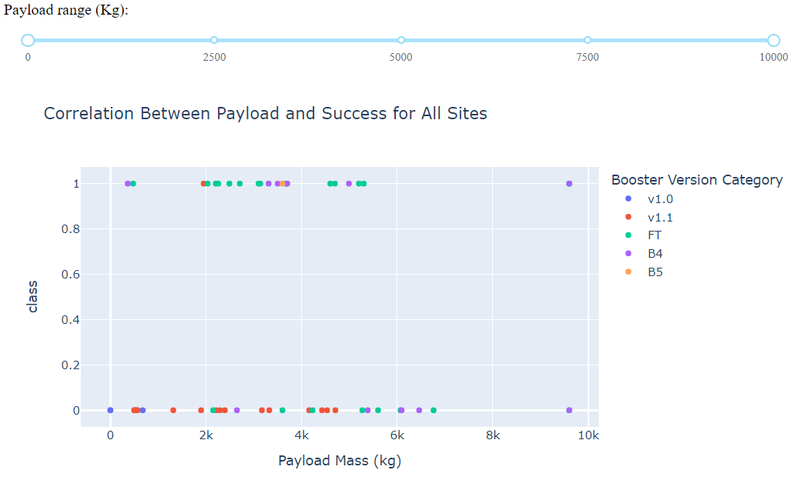
Results
Exploratory data analysis, including interactive dashboard allowed to discover variables that could be candidates for strong predictors.
Predictive analysis results revealed that 3 models have similar performance results on test set: logistic regression, SVM, and k-nearest-neighbors classifier, while k-nearest-neighbors classifier has the best performance on train set.

Slide 17

Section 2

Slide 18
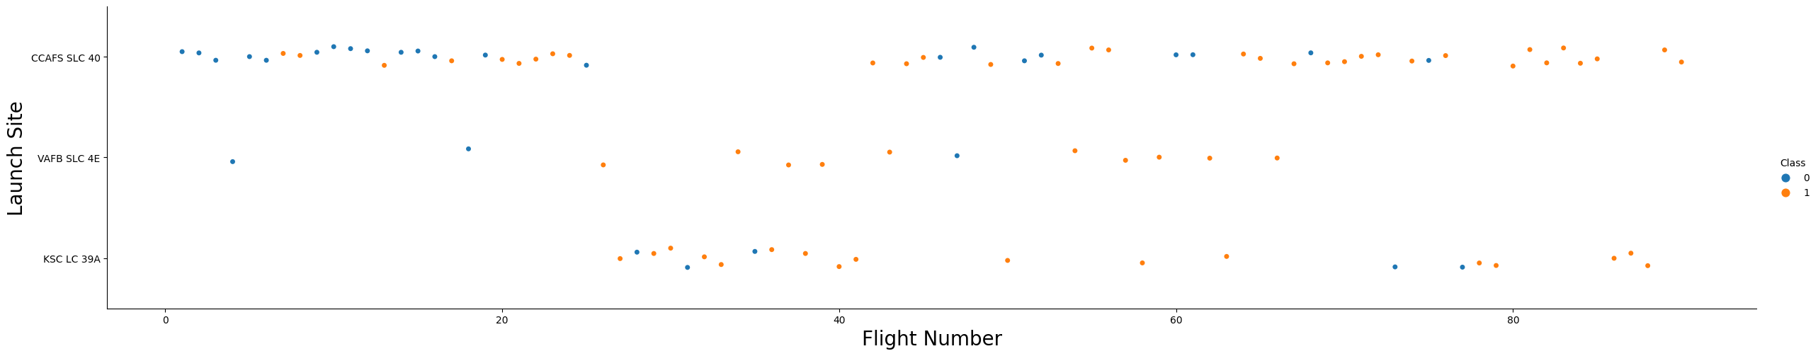
Flight Number vs. Launch Site
Site CCAFS SLC 40 is the most used site with mixed results. Site VAFB SLC 4E has been used the least. The scatter plot reveals that earlier launches had lower success rate than the later ones.

Slide 19
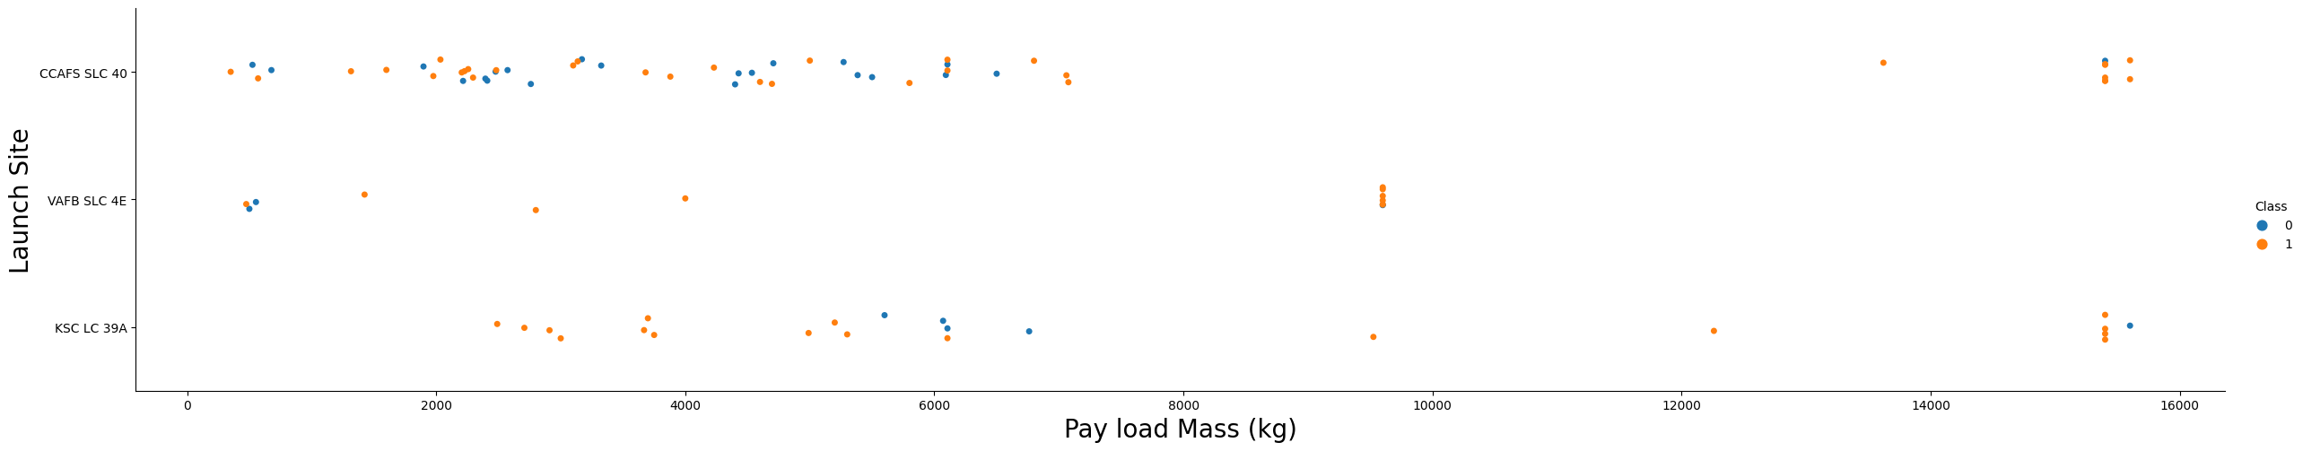
Payload vs. Launch Site
The graph demonstrates higher success rate for launces with higher payload mass.

Slide 20
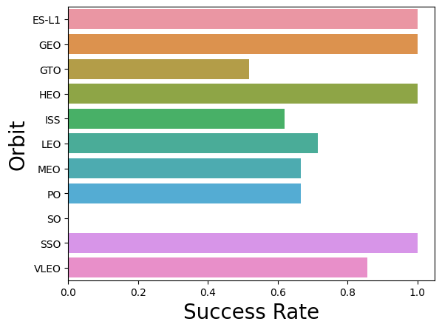
Success Rate vs. Orbit Type
The graph demonstrates outstanding success rate for orbits ES-L, GEO, HEO, and SSO, while launches to the orbit SO were highly unsuccessful.

Slide 21
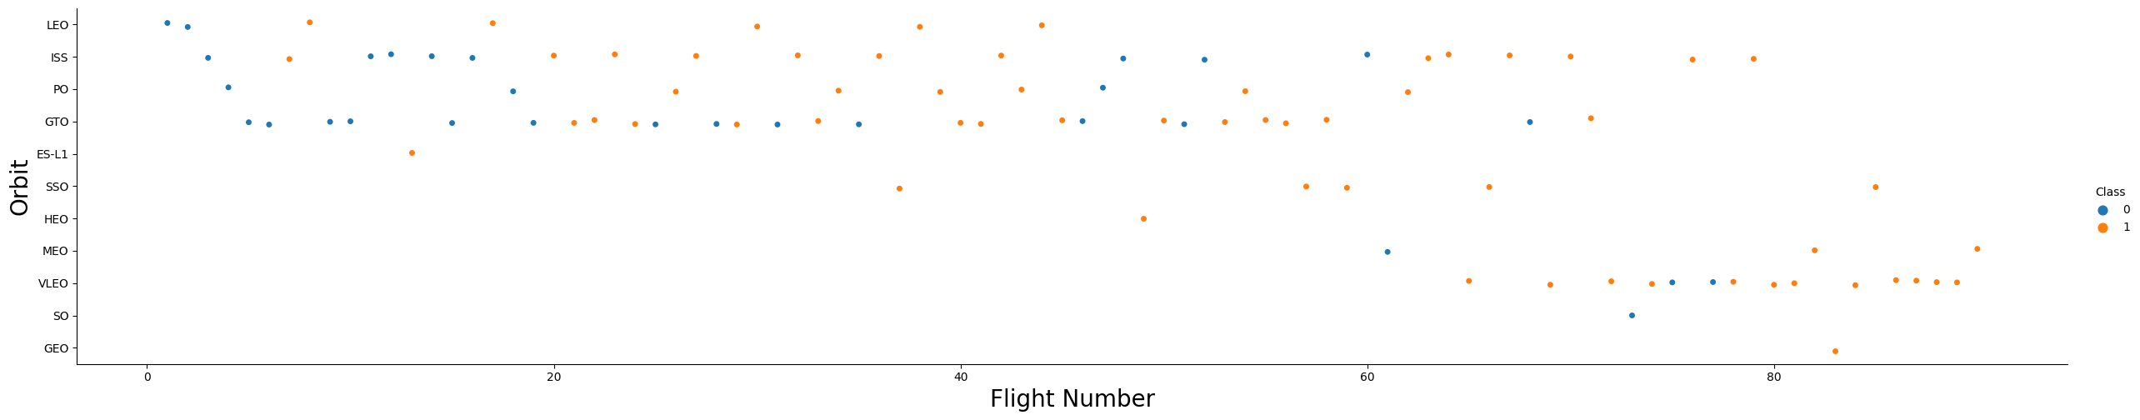
Flight Number vs. Orbit Type
The graph demonstrates that the launches switched to different orbits.

Slide 22
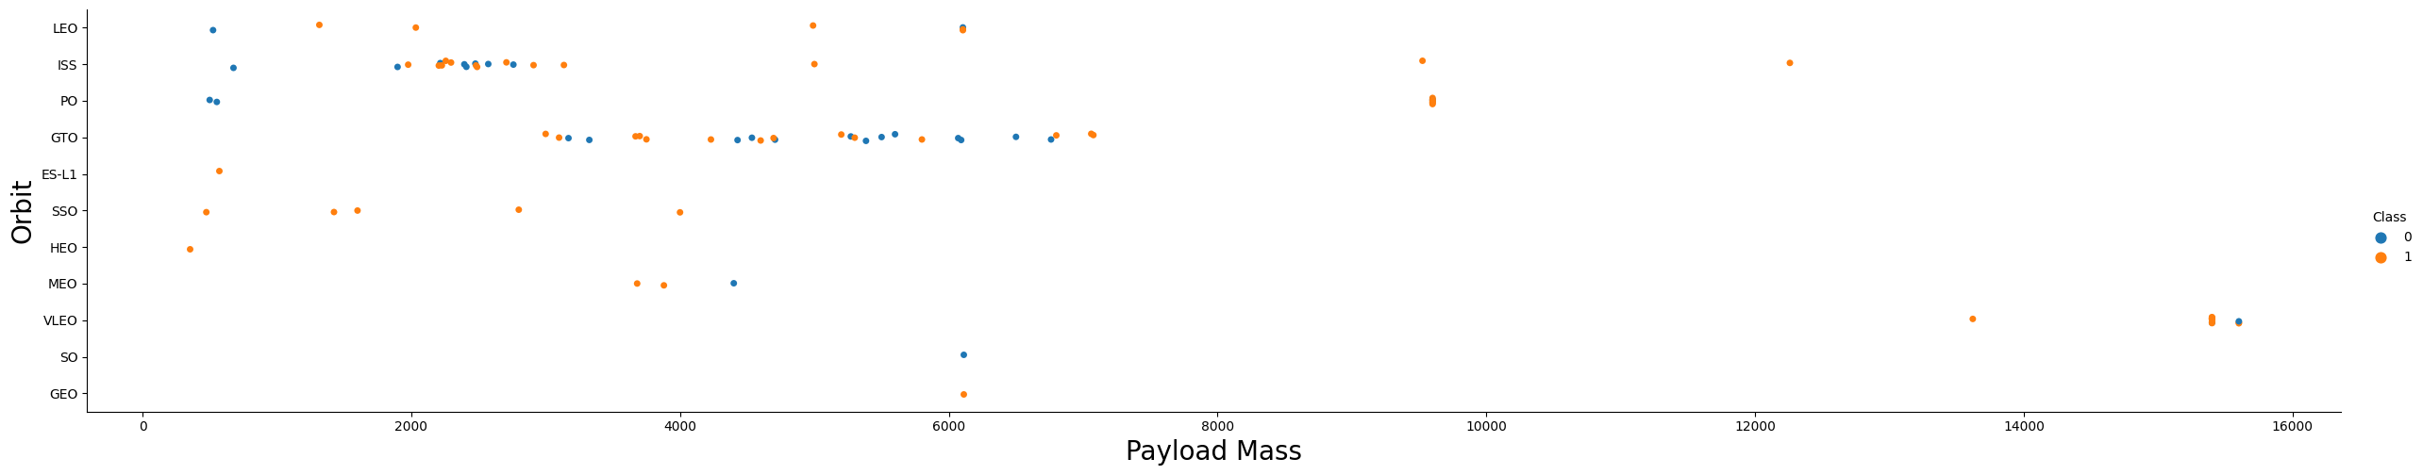
Payload vs. Orbit Type
The graph demonstrates that with heavy payloads the successful landing or positive landing rate are more for PO, LEO and ISS.

Slide 23
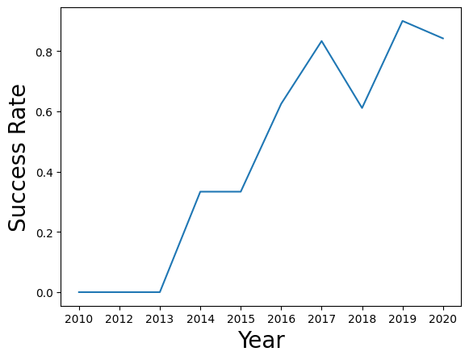
Launch Success Yearly Trend
The graph demonstrates that the success rate since 2013 kept increasing till 2020.

Slide 24
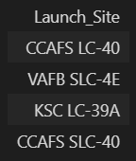
All Launch Site Names
The names of the unique launch sites:

Slide 25
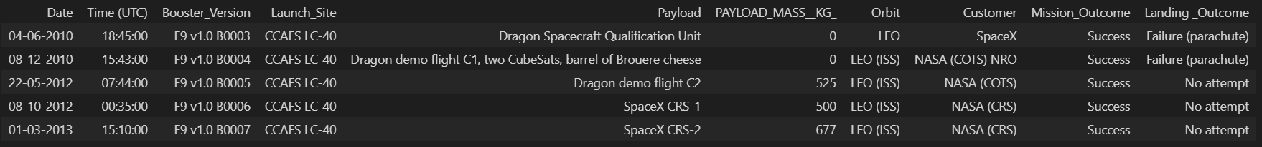
Launch Site Names Begin with 'CCA'
5 records where launch sites begin with `CCA`:

Slide 26
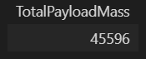
Total Payload Mass
The total payload carried by boosters from NASA:

Slide 27
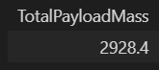
Average Payload Mass by F9 v1.1
The average payload mass carried by booster version F9 v1.1:

Slide 28

First Successful Ground Landing Date
The dates of the first successful landing outcome on ground pad:

Slide 29
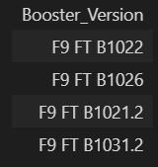
Successful Drone Ship Landing with Payload between 4000 and 6000
The names of boosters which have successfully landed on drone ship and had payload mass greater than 4000 but less than 6000:

Slide 30
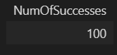
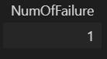
Total Number of Successful and Failure Mission Outcomes
The total number of successful and failure mission outcomes:

Slide 31
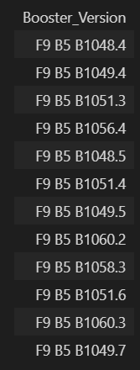
Boosters Carried Maximum Payload
The names of the booster which have carried the maximum payload mass:

Slide 32
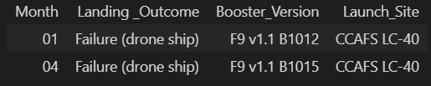
2015 Launch Records
The failed landing_outcomes in drone ship, their booster versions, and launch site names for in year 2015:

Slide 33
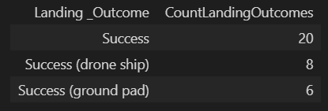
Rank Landing Outcomes Between 2010-06-04 and 2017-03-20
The rank the count of landing outcomes (such as Failure (drone ship) or Success (ground pad)) between the date 2010-06-04 and 2017-03-20, in descending order:

Slide 34

Section 3

Slide 35
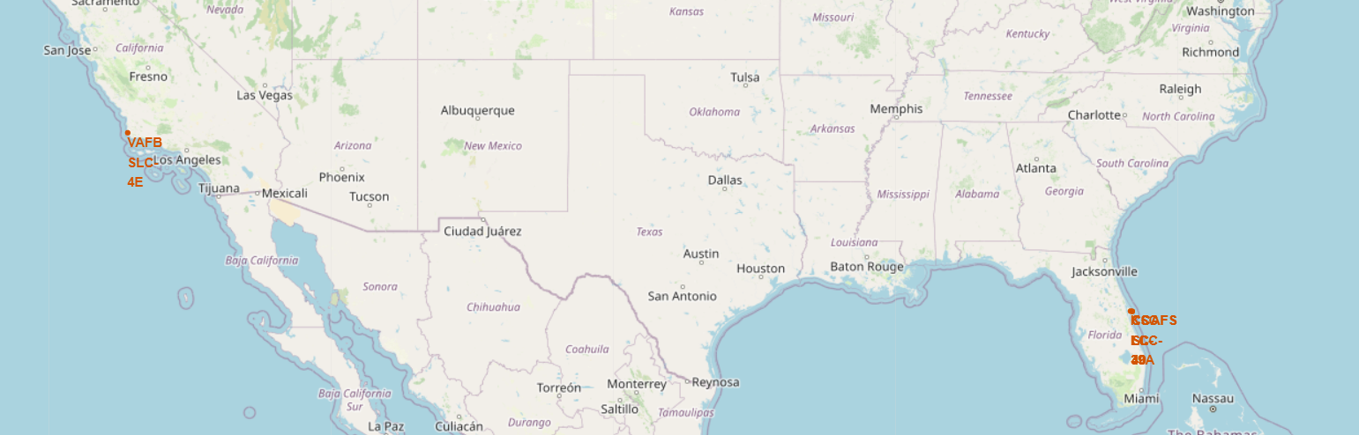
Map of all launch sites
This map shows locations of all launch sites

Slide 36
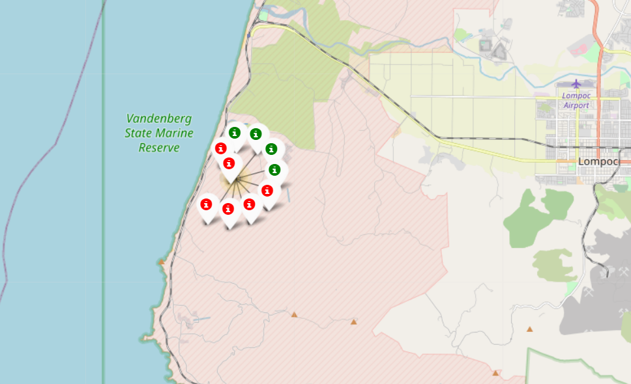
Launch outcomes for site VAFB SLC-4E
This map demonstrates successful and failed launches for the launch site VAFB SLC-4E

Slide 37
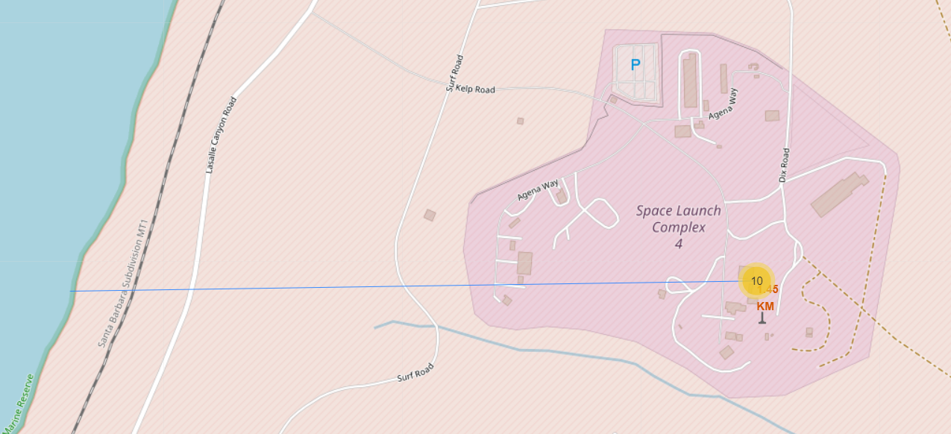
Proximity of the launch site VAFB SLC-4E to coastline
This map shows proximity of launch site VAFB SLC-4E to the coastline with calculated distance on km.

Slide 38

Section 4

Slide 39
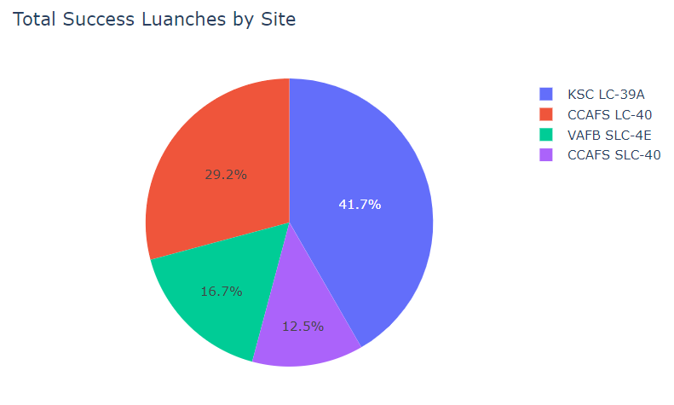
Launch success count for all sites
The chart demonstrates the launch success count for all sites in percentage of total successful launches
The highest percentage of successful launches happened on site KSC LC-39A

Slide 40
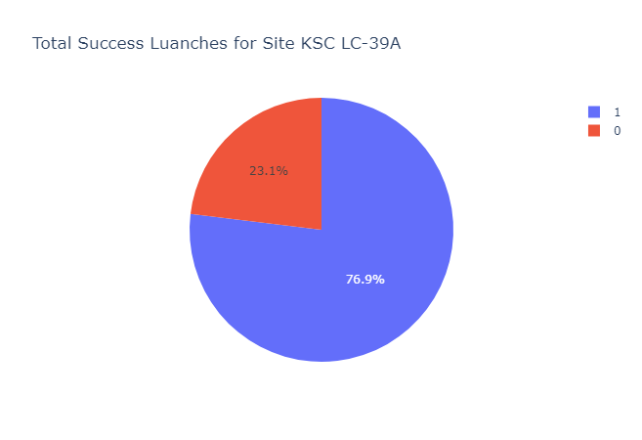
Launch success ratio for the site KSC LC-39A
The graph demonstrates launch success ratio for the site KSC LC-39A
The percentage of successful launches (in blue) is 76.9%, while the percentage of failures (red) is 23.1%

Slide 41
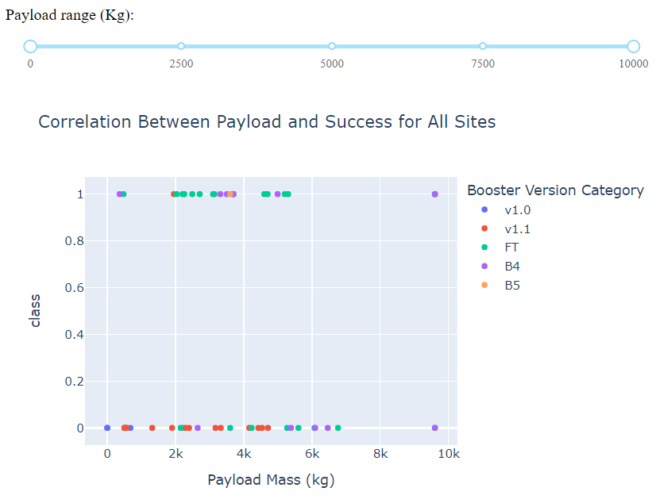
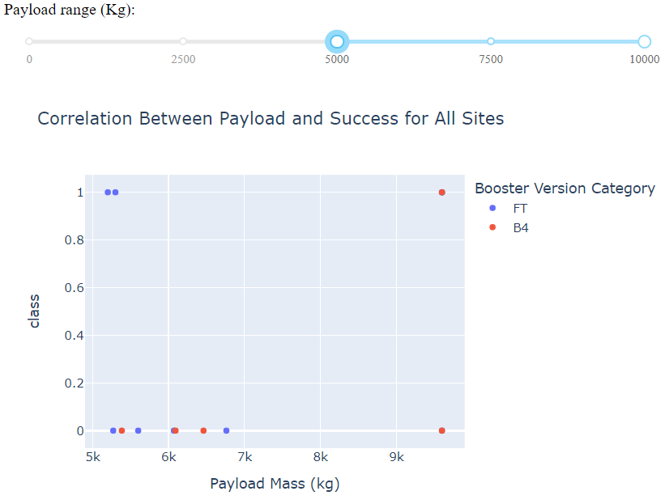
<Dashboard Screenshot 3>
The graphs demonstrate correspondence of launch outcomes to payload mass and booster version. Chart of the left visualizes data for all sites and the full range of payloads, while the chart of the right is focused on payload over 5000 Kg.

Slide 42

Section 5

Slide 43
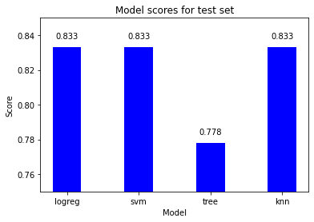
Classification Accuracy
3 models have similar performance results on test set: logreg, svm, and knn.
Out of these 3 options, knn has the best performance on train set.

Slide 44
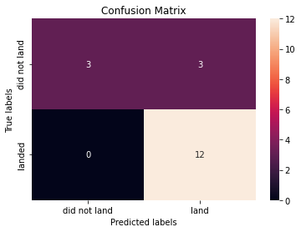
Confusion Matrix
Confusion matrix form k-nearest neighbor model
The matrix is divided into four quantiles:
The first (upper left) and the third (lower right) quantiles demonstrate correct classification (15 out of 18 cases)
The second (upper left) and the fourth (lower left) quantiles demonstrate incorrect classification (3 out of 18 cases)

Slide 45
Conclusions
Earlier launches had lower success rate than the later ones.
Launces with higher payload mass had higher success rate. Launches for orbits ES-L, GEO, HEO, and SSO has outstanding success rate, while launches to the orbit SO were highly unsuccessful. Over time launches switched to different orbits.
The highest percentage of successful launches happened on site KSC LC-39A. 76.9% launches on this site were successful.
Overall success rate since 2013 kept increasing till 2020.
Four ML models were built to predict outcomes a prospective lunch. K-nearest neighbor model has the highest predictive accuracy both for training and test sets (85% and 83%).

Slide 46
Appendix
The project Git repository: https://github.com/andriy-savka/IBM-Applied-Data-Science-Capstone.git

Slide 47


